Slide 1


History Taking in Older Adults
Geriatrics Hub
Dr. Thiru Yogaparan MD, FRCPC
Associate Professor, University of Toronto
Baycrest Health Sciences

Slide 2
Goals and objectives
At the end learners will be able to
Understand basic principles of communication with older adults
Analyze the differences in geriatric history taking compared to young adults
Discuss the importance of different components of a geriatric history
Understand the importance of functional status and its components
Describe potential barriers and mitigation strategies
Describe an approach to geriatric history taking
Notes:
assumption is you know how to take a medical history

Slide 3
Ageism
Ageism is the most common form of discrimination in the society
You can be an ageist without your knowledge
Older adults can be ageist

Slide 4
Treat with Respect
Dear, Darling, Sweetie, Cutie and Honey are not appropriate
Always use Mr. / Mrs., use last name or ask them how they would like to be addressed
Show respect
Convey patience
Show cultural awareness
“All of a sudden I have lost my identity, they do not want to call me Mrs. Thomas anymore, they call me honey or sweetie”

Slide 5
Remember Who the Patient is
Introduce yourself
Always address the patient first
Ask permission from patient
  “Is it okay if I talk to your daughter?”
Even patients with moderate dementia are able to give some history

Slide 6
History Taking
In young adults usually you would start with identifying information , chief complaint followed by history of presenting illness(HPI)
There is no perfect order when taking history in older adults
In ambulatory settings, It is useful to obtain past medical history and medication history before history of presenting illness as they may be contributing e.g.
  Long standing diabetes with peripheral neuropathy and bezos taken at night may be contributing to the falls

Slide 7
History Taking
When suspecting dementia, starting with social history and family history is less threatening to the patients
If they are struggling to give important personal information such as number of children or their education , you can gauge their impairment
A simple question such as
“I want to get to know you or tell me about yourself, before we go into the details of your memory concerns “
“How did you get here” may give a lot of information

Slide 8

Reason for Referral or Presenting Symptoms
Notes:
Only the tip of the iceberg

Slide 9
History Taking : HPI
Compared to young adults, remember seniors have
Multiple problems
Atypical presentation
Functional decline may be the only presenting complain for various illness
Underreporting is common

Slide 10
Multiplicity and Heterogeneity
Geriatric patients often have
  Multiple problems
  Multiple complaints
One symptom may have multiple underlying causes/pathology
You may have to ask the patient and family to prioritize and deal with few issues each visit
If feasible obtain information before the visit
Heterogeneity is the rule in older adults

Slide 11
Rule of Parsimony often Fails in Geriatrics
Occam's razor: The generalization states that, if there are a number of explanations for observed phenomena, the simplest explanation is preferred, called also scientific parsimony
The law of parsimony tells us that we should look at the organ system specific to the patient’s symptoms and positive exam findings to arrive at the correct diagnosis- works well with young patients
Do not try to clump symptoms to come to a unifying diagnosis in geriatric patients as they may have several underlying problems even for one symptom

Slide 12
What Is An
Atypical Presentation?
“When an older adult presents with a disease state that is missing some of the traditional core features of the illness usually seen in younger patients”.
Atypical presentations usually include one of 3 features:,
  Vague presentation of illness
  Altered presentation of illness e.g. minimal symptoms compared to the severity of illness
  Non presentation of illness (i.e., underreporting).
Atypical presentation is the typical presentation in frail older adults
It is important for clinicians to recognize these atypical presentations and not miss the underlying diagnosis
Notes:
ED1/ 5-1/3 of presentation

Slide 13
HPI: Typical Atypical Presentation
Functional decline
“Something wrong”
“Not himself or herself”
“Feeling week”
Geriatric syndromes
  Altered Mental Status
  Failure to eat or drink
  Reduced Mobility
  Fall
  Fatigue
  Urinary Incontinence
Factors associated with increased risk of an atypical presentation include:
Age of 85 years or over
Multiple comorbidities
Polypharmacy
Cognitive / Functional Impairment
Frailty

Slide 14
Under Reporting
Under reporting of symptoms is extremely common
  Attributing to normal aging
  Fear of hospitalization/institutionalization
  Negative attitude
  Cognitive impairment
  Fear of being a burden to family
“What do you expect at my age?”
“My daughter is going to worry if she gets to know that I had 2 falls this month”

Slide 15
Collateral History
Caregiver interview is extremely important, specially in patients with cognitive impairment
  Patients may talk from their past and report a higher functional and cognitive status, hence it is important to corroborate the information if you suspect cognitive impairment
Caregiver interview can be done in the presence of the patient or in private , at times you may require both
Pay attention to body language of the caregivers
Corroborate and expand patient’s history with caregivers
Assess caregiver burden
When no family is available, you may get information from involved heath care providers

Slide 16
Past Medical History
Older adults may have multiple medical issues and a lengthy past medical history
Even cognitively intact patients may not remember all the details, hence review of previous medical records very useful
In the presence of chronic medical conditions, it is important to know the duration, complications, previous control and treatments

Slide 17

Medications
Medications – it is very important you review all the medications( Covered in detail in medication history taking module on Medications section)
Prescription
OTC
Herbal
Nutritional supplements
Allergies
Previous drug responses and reactions
How they are taken
This Photo by Unknown Author is licensed under CC BY-SA

Slide 18
Social History & Family History
In addition to usual social history ask about
Living environment and current support system - crucial to develop treatment plans
Educational status, occupation and time of retirement
  Often people take pride in their occupation , also will help to assess their cognition e.g. an accountant struggling to do serial sevens
Updated will & power of attorney(POA) for health and finances
“Just because I am 99, this young doctor never bothered to ask me what I did for living. He did not know I was a dean at one point””

Slide 19

Social History & Family History
Screen for loneliness
Screen for poverty when applicable
Ask about leisure
Do not forget to ask about substance use and abuse,
  ETOH often overlooked
  ETOH abuse may present as falls, cognitive impairment ,functional decline
  A patient with dementia who smoke is a fire risk
Obtain family history targeted to history of longevity, Cognitive impairment, parents’ and siblings’ end-of life experiences
“Please tell me about your typical day”
This Photo by Unknown Author is licensed under CC BY-ND

Slide 20
Sexual History
Most patients across all age groups consider sexuality as an important part of life.
Sexual history is often not obtained in older patients.
Taking a sexual history in the primary care setting may be difficult for patients and clinicians.
Patient-specific barriers include feelings of shame or concern about their physician’s reaction to discussions regarding sexual health, particularly among sexual and gender minorities.
Clinician-specific barriers include inadequate training, lack of time, and discomfort with the topic.

Slide 21
Sexual Health Assessment for Older Adults
Sexual health is an important component of your physical and emotional well-being. May we further discuss your sexual health?
Have you been sexually active in the past year? If so, how many sexual partners have you had?
Do you have sex with men, women, or both?
Do you have any concerns or questions related to sex or your overall sexual health?
Our sexual function may change as we age. In what ways has your sexual function changed?
What information can I provide to help you fulfill your goals regarding your sexual health?

Slide 22

Dentition, Nutrition/Weight
Under nutrition is a
common problem.
Establish
Access to food
Dentition
Dietary habits
Weight history
Causes of weight loss in older adults – MEALS ON WHEELS
Medications (e.g, digoxin, theophylline, SSRIs, antibiotics)
Emotional (e.g., depression, anxiety)
Alcoholism, older adult abuse
Late life paranoia or bereavement
Swallowing problems
Oral factors (tooth loss, xerostomia)
Nosocomial infections (e.g., tuberculosis, pneumonia)
Wandering and other dementia-related factors
Hyperthyroidism, hypercalcemia, hypoadrenalism
Enteral problems (e.g., esophageal stricture, gluten enteropathy)
Eating problems
Low salt, low cholesterol, and other therapeutic diets
Social isolation, stones (chronic cholecystitis)
This Photo by Unknown Author is licensed under CC BY

Slide 23
Elder Abuse
Elder abuse is an important cause of morbidity and mortality in older adults
The Elder Abuse Suspicion Index is a validated tool for use by family physicians to help identify such abuse.

Slide 24
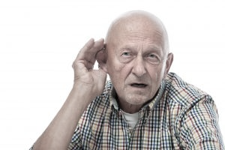
Hearing impaired –Helpful Tips
Find a quiet place
Speak slowly in deep tone
Face the patient, so they could read your lips
Write down questions in large print
Rephrase the question
Use pocket talker, even your stethoscope could be used
This Photo by Unknown Author is licensed under CC BY-NC-ND

Slide 25

Visual Impairment
Well lit room
Magnifying glass
This Photo by Unknown Author is licensed under CC BY-SA-NC

Slide 26
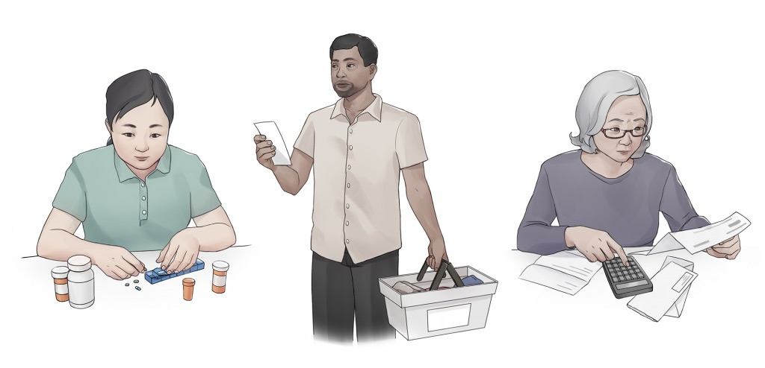
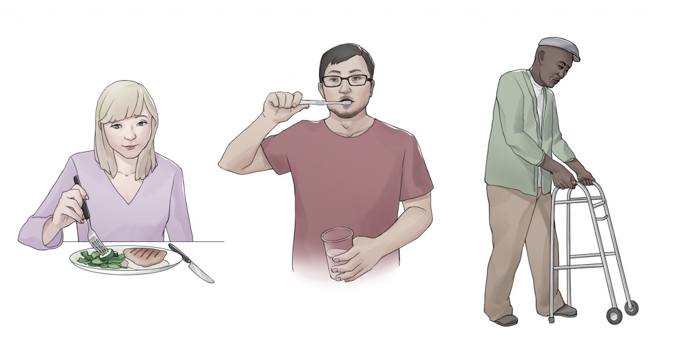
Functional Status
This Photo by Unknown Author is licensed under CC BY-SA
This Photo by Unknown Author is licensed under CC BY-SA

Slide 27
Functional Status
Important component of geriatric assessment
Always obtain functional status irrespective of the setting
Geriatric history without functional assessment is useless
However functional assessment is useful only in the context of a complete medical history and physical examination
Any recent change in functioning may indicate an underlying medical problem
If there has been a change in function it is important to get further history about
  Baseline functioning
  When it changed
  Current functioning
This will be especially important when dealing with ill, hospitalized older adults
Notes:
Imagine you have completed a traditional full medical history and physical exam but you didn’t know that the patient cannot go to the bathroom without assistance, what is the usefulness of your assessment?

Slide 28
Imagine an older adult who lives alone is ready to go home after a hospital admission for pneumonia as she is no longer short of breath and is feeling better. You did not know, now she needs assistance to go to the bathroom.
Or
An older adult who is on anticoagulants and diabetic medications is no longer able to take his medications as prescribed secondary to resolving delirium
What could happen to these patients if you didn’t know?

Slide 29
Basic Activities of Daily Living (BADL) & Instrumental Activities of Daily Living (IADL)
BADLs -Asses self care capabilities
IADLS -Assess living independence
BADL- (DEATH)
IADL- (SHAFT)
A mnemonic for functions : Losing your functions is like falling down the
DEATH SHAFT
Notes:
Get info about adoptive equipments e.g. walker, raised toilet seat
Get details of the assistance
Show them Katz ADL assessment

Slide 30
BADLs
To help the patients it is important to know for each functions if they are
Independent
Needs supervision
Needs assistance
Dependent
Why they need help
Who is helping them and how often they receive help
Dressing
Eating
Ambulation + find out about Assistive devices
Toilet/ Transfer
Hygiene

Slide 31
Katz - ADL
Can be used to assess basic activities of daily living.
In this tool mobility is only assessed by transfers
https://www.alz.org/careplanning/downloads/katz-adl.pdf

Slide 32
IADL
Shopping
Housekeeping
Accounting
Food preparation
Telephone /Technology/ Transportation
Get to know the current support system and ask them how they manage.
If they cannot do something, ask why e.g. Banking done by the family because of poor memory vs. unable to walk to the bank secondary to severe arthritis and pain Vs unable to sign the check because of the tremors

Slide 33
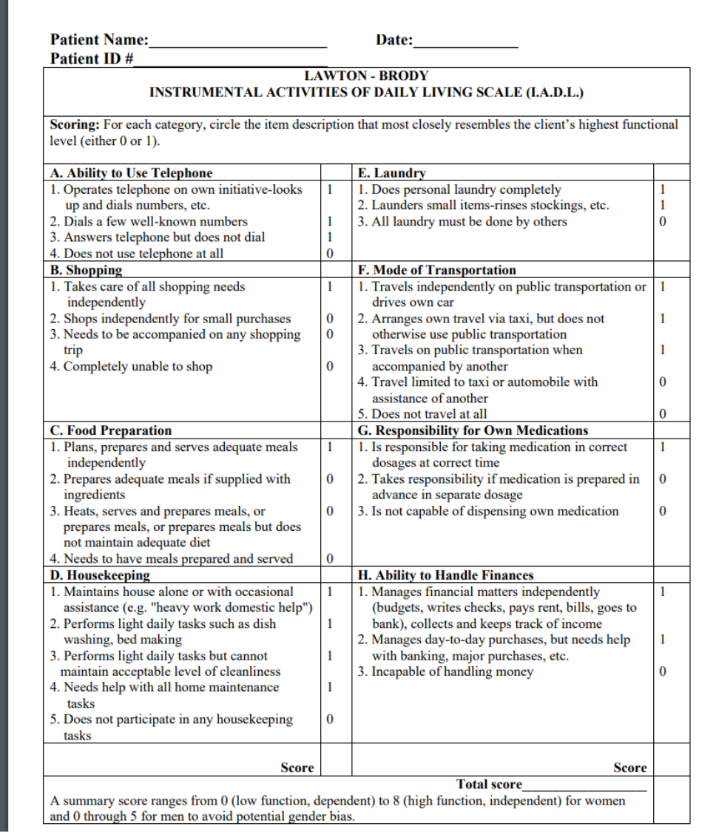
Lawton –Brody IADL scale
Can be used to assess IADLs
https://www.alz.org/media/documents/lawton-brody-activities-daily-living-scale.pdf

Slide 34
Assistive Devices and Safety Modifications
In people with functional impairments, ask if they use any assistive devices , and circumstances they are used
Ambulatory aids: Cane, walker, wheel chair, mobility scooters
Transfer devices : grab bars and poles, pivot aids, transfer boards, lifts , assistive straps
Stairs : side rail, stair lift, ramps
Bathroom equipment's: rails, bath seat, hand held shower , transfer bench , raised toilet seat
Dressing aids: Reacher, shoe horn, dressing stick
Falls detection devices ( In patients with poor balance or falls)
Wandering bracelet ( In patients with dementia)

Slide 35
Safety Concerns
Potential fall hazards
  E.g. loose rugs , wires and other tripping hazards ,clutter, lighting
Fire hazards
More important in the setting of cognitive impairment
  e.g. Leaving the stove on, burning pots while cooking , using candles or oil lamp for praying, smoking
Flooding
  E.g. forgetting to turn the tap off
Bug infestation

Slide 36
Geriatric System Review
Vision
How is your vision? Can you read a newspaper? (with your glasses on?), last vision check
Hearing
How is your hearing? Use of hearing aid, last hearing check
Memory
How is your memory?
Mood
How is your mood?
Bladder
Do you ever lose control of your bladder? Frequency, nocturia,
Bowels
How are your bowel habits?
Balance and falls
How is your balance? Have you ever had any falls or fractures?
Dentition, appetite and weight
Any dental issues? Last dental check up ,How is your appetite? Have you lost any weight?
Sleep
Pain
How is your sleep?
Do you have any pain?
Get more details if any of the above are positive

Slide 37
Value history
In ambulatory settings value history can be obtained over several follow up visits, however in acute care settings when patients are acutely ill value history is important and treatment decisions will be based on patients values and preferences.
Discuss
  What matters most to the patient
  Goals of care
  Preferences for care
  Advance directives e.g. full code , DNR
  Quality of live Vs life prolongation

Slide 38
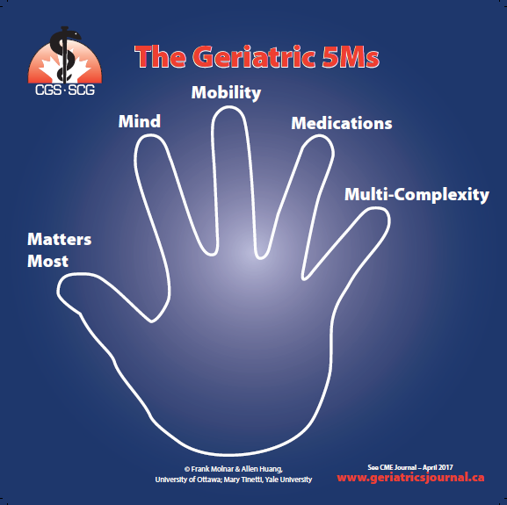
5 M

Slide 39
References
https://www.merckmanuals.com/en-ca/professional/geriatrics/approach-to-the-geriatric-patient/evaluation-of-the-older-adult
Bickley, Lynn S. (2003). Bates' guide to physical examination and history taking. Philadelphia :Lippincott Williams & Wilkins,
Tatum Iii PE, Talebreza S, Ross JS. Geriatric Assessment: An Office-Based Approach. Am Fam Physician. 2018 Jun 15;97(12):776-784. PMID: 30216018.
Nathaniel P, Joshua Khalili .The Importance of Obtaining Sexual History in Older Adults.A Teachable Moment.JAMA Intern Med. Published online October 7, 2019.doi:10.1001/jamainternmed.2019.4480
Omole F, Fresh EM, Sow C, Lin J, Taiwo B, Nichols M. How to discuss sex with elderly patients. J Fam Pract. 2014;63(4):E1-E4.
John E. Morley, Anorexia and Weight Loss in Older Persons, The Journals of Gerontology: Series A, Volume 58, Issue 2, February 2003, Pages M131–M137, https://doi.org/10.1093/gerona/58.2.M131

