Slide 1
Comprehensive Geriatric Assessment (CGA) Geriatrics Hub
Dr. Thiru Yogaparan MD, FRCPC
Baycrest Health sciences
Associate professor
University of Toronto

Slide 2
Goals And Objectives
At the end of the session you will be able to
Describe : definition ,purpose, components and benefits of CGA
Identify patients who would benefit from a CGA

Slide 3
What is a CGA?
“CGA is a multidisciplinary evaluation in which the multiple problems of older persons are uncovered, described, explained if possible and in which the resources and strengths catalogued needs for services assessed and a coordinated care plan developed to focus on the person’s problem”
Notes:
Best definition

Slide 4
History of CGA

Slide 5
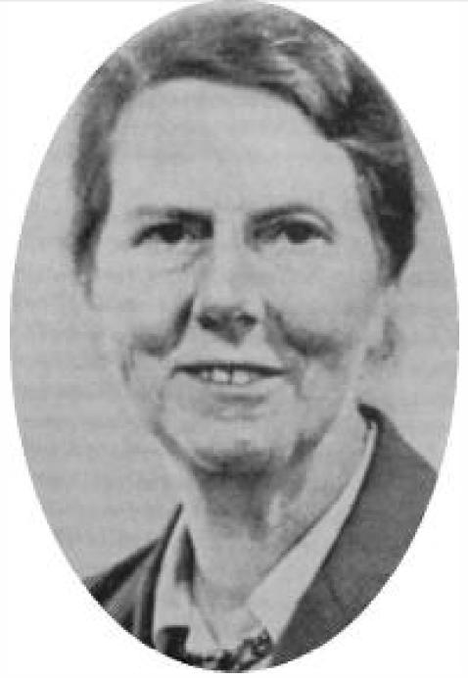
Dr. Marjory Warren
The roots of modern CGA practice go back approximately 85 years and are conventionally traced to the work of Dr. Marjory Warren in the United Kingdom
“In modern medical practice, suffering tends to be reduced to a mathematical equation. We speak of morbidity and mortality rates, incidence of disease, and survival time. Assessment of disease in these terms gives direction to further study and indicates its urgency. But there is a danger of mistaking a calculated solution for a remedy, forgetting that finally we are treating not a disease, but a person.”
The mother of modern
Geriatric Medicine

Slide 6
History: Works of Dr. Warren
1935 Dr. Marjory Warren took over the care of 714 chronic sick patients. A "workhouse infirmary“-The hospital had been filled with old patients who were neglected and bed ridden
By systematically evaluating all 714 patients, Warren was able to determine who might benefit by medical and rehabilitation efforts and who will require residential care
She remobilized a majority of these patients and in many cases discharged them to their homes
714 →200 pts, 35% discharged home
Warren created a specialized geriatric assessment unit in a large chronic disease hospital
These experiences led her to become a leading proponent of comprehensive assessment of older adults and she is considered as one of the pioneers of geriatric medicine
CGA is now applied internationally

Slide 7
Why CGA ?
Systemic evaluation of a frail older person by a team of health care professionals can uncover treatable health problems and lead to improved health outcomes
When compared to ‘usual care’ in RCTs in hospital settings, CGA has been shown to have positive effects on key outcomes.
A major difference between geriatric medicine and adult medicine is the emphasis on a holistic approach
A holistic, systematic approach needs to be adopted by health care providers mainly because of the complex needs of seniors
In view of the complexity an Interprofessional team is necessary
A cookie cutter approach will fail to serve the seniors

Slide 8
4 Dimensions of CGA
CGA
Physical
Health
Problem list Comorbid conditions
and
disease severity Medication review Nutritional status
Functional
status
Mood and
Cognition
Mental status (cognitive)
testing Mood/depression
testing
Socio environmental
factors
Informal support needs
and assets Care resource eligibility/
financial assessment
Environmental assessment
Home safety Transportation and
telehealth
Basic activities of
daily living Instrumental activities of
daily living Activity/exercise status Gait and balance

Slide 9
World Health Organization(WHO): Domains - Assessment of Older Patients
Physical health
Mental function: cognitive and psychiatric symptoms
Functional capacity: basic activity of daily living and instrumental activity of daily living
Social resources
Environmental resources
Economic resources

Slide 10
Sample CGA assessment form : FI- CGA

Slide 11
CGA : Care settings and teams
Can be inpatients or outpatient settings
The range of health care professionals working in the core assessment team varies based on the resources
In many settings a core team consist of
Physician
Nurse
Social worker
Physiotherapists
Occupational therapists
Traditionally, the various components of the evaluation are completed by different members of the team

Slide 12
Who will benefit
No criteria have been validated to readily identify patients who are likely to benefit from CGA
Many seniors will benefit, however given the limited resources programs use specific criteria
E.g. Specific criteria used by CGA programs to identify patients include
Multiple medical co morbidities
Specific geriatric conditions such as dementia, falls, frailty or functional disability or decline
Previous or predicted high health care utilization
Consideration of new treatment e.g. surgery, chemotherapy
Consideration of change in living situation (e.g. from independent living to assisted living, nursing home, or in-home caregivers)

Slide 13
CGA: Process
Targeting appropriate patients
Assessing patients and developing recommendations
Implementing recommendations
Proper follow up & implementation of recommendation, monitoring response to the treatment plan and revising the treatment plan adds to the success of CGA

Slide 14
Comprehensive geriatric assessment: goals
To improve process of care:
Improve diagnostic accuracy
Improve medical treatment
Arrange for long-term case management
To improve outcomes of care:
Improve functional status
Better quality of life
To contain costs of care:
Reduce use of unnecessary formal services
Prolong tenure in the home/community
CGA

Slide 15
Comprehensive geriatric assessment for older adults admitted to hospital (Review) 1 Copyright © 2011 The Cochrane Collaboration
Authors’ conclusions
Comprehensive geriatric assessment increases a patient’s likelihood of being alive and in their own home at up to 12 months
Plain language summary-comprehensive geriatric assessment for older adults admitted to hospital
This review investigates whether specialist, organized and coordinated geriatric care CGA is better for patient outcomes than conventional care in a hospital setting
There is a clear and significant Improvement in the chances of a patient being alive and in their own home at up to a year after an emergency hospital admission if they receive coordinated specialist services
This effect is consistently seen from trials of geriatric wards where patients are admitted to a dedicated ward area and receive care from a specialist multidisciplinary team
This effect was not clearly seen where patients remained In a general ward and received assessment from a visiting specialist multi-disciplinary team

Slide 16
References
Stuck AE, Siu AL, Wieland GD, Adams J, Rubenstein LZ. Comprehensive geriatric assessment: a meta-analysis of controlled trials. Lancet 1993; 342: 1032–6.
Conroy SP, Stevens T, Parker SG, Gladman JR. A systematic review of comprehensive geriatric assessment to improve outcomes for frail older people being rapidly discharged from acute hospital: ‘interface geriatrics’. Age Ageing 2011; 40: 436– 43.
Tinetti ME, Fried T. The end of the disease era. Am J Med 2004; 116: 179–85.
Welsh, T. J., Gordon, A. L., & Gladman, J. R. (2014). Comprehensive geriatric assessment - a guide for the non-specialist. International Journal of Clinical Practice (Esher), 68(3), 290–293. https://doi.org/10.1111/ijcp.12313
Parker SG, McLeod A, McCue P et al. New horizons in comprehensive geriatric assessment. Age Ageing 2017. https://
doi.org/10.1093/ageing/afx104.
Ellis G, Whitehead M, O’Neill D, Langhorne P, Robinson D. Comprehensive geriatric assessment for older adults admitted
to hospital. Cochrane Database Syst Rev 2011a. doi:10.1002/ 14651858.CD006211.pub2.
Warren MW. Care of the chronic sick. Lancet 1946; 1: 841–3.

