Slide 1

An introduction to Geriatric Oncology
Shabbir M.H. Alibhai, MD, MSc, FRCP(C)
Professor,
Dept. of Medicine, University Health Network and University of Toronto
Research Scientist, CCSRI

Slide 2
Learning objectives
To review cancer epidemiology in older adults
To review the challenges of managing cancer in older adults
To describe how aging may affect the toxicities of cancer treatment
To understand the value of geriatric assessment in older adults with cancer

Slide 3
Outline
What is geriatric oncology?
Burden of cancer in older adults
What’s so special about growing old?
Age and treatment toxicity
Value of comprehensive geriatric assessment in oncology
Summary

Slide 4
What is geriatric oncology?
The field has come of age in the past 15-20 years
No one precise definition of a ‘geriatric’ patient; commonly 65 was used based on (forced) retirement ages in Western countries
Among geriatricians, 65-74 are ‘young old’, 75-84 are ‘medium old’, and 85+ are ‘oldest old’
A growing consensus in geriatric oncology is using age 70 or 75 as the typical threshold because of accelerated frailty/decline after

Slide 5
Outline
What is geriatric oncology?
Burden of cancer in older adults

Slide 6
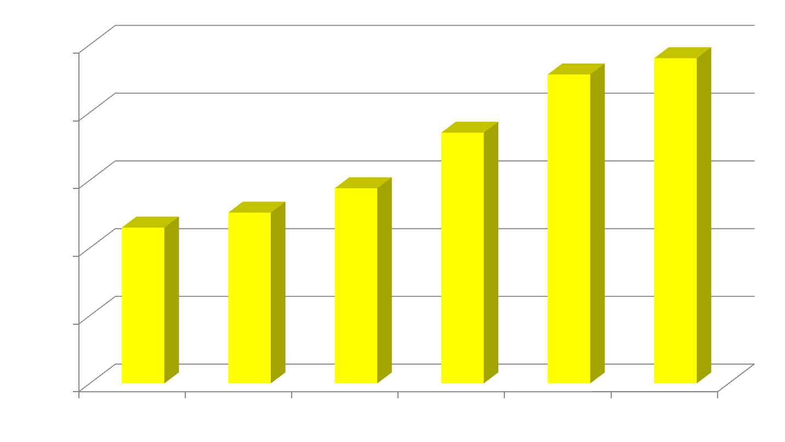
Canadian Population Age > 65
Year
Ottawa: Statistics Canada, 2011
Notes:
6

Slide 7
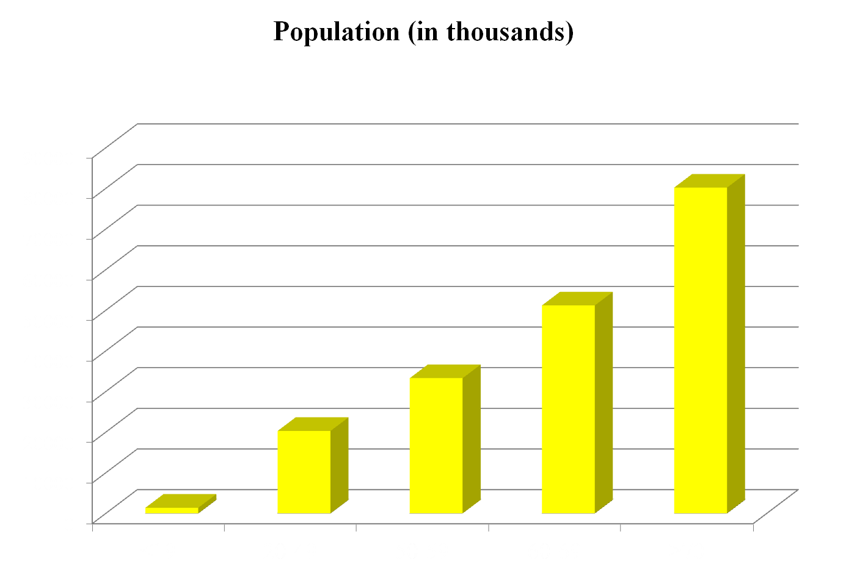
Cancer and Aging
60% of cancer occurs in people > age 65
Population
with Cancer
Age Groups
Canadian Cancer Statistics, 2012

Slide 8
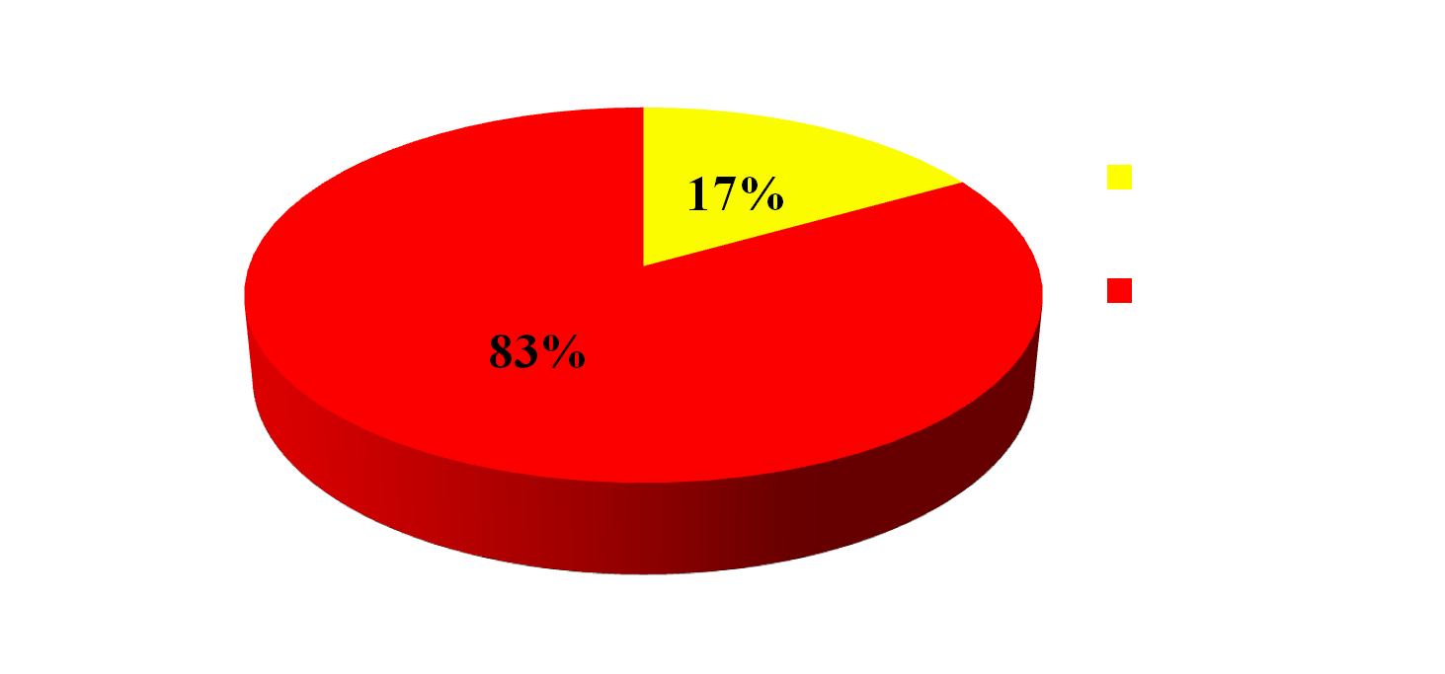
Cancer and Mortality
Majority of Cancer Deaths Occur in Older Adults
Canadian Cancer Statistics, 2012

Slide 9
Burden of cancer in older adults
Older adults are fastest growing age group in Western countries
About 60% of all cancers occur in age 65+
71% of all cancer deaths in age 65+
Odds of dying from cancer are 16-fold higher in people age 65+ compared to <65

Slide 10
Burden of cancer in older adults
Older adults are fastest growing age group in Western countries
About 60% of all cancers occur in age 65+
71% of all cancer deaths in age 65+
Odds of dying from cancer are 16-fold higher in people age 65+ compared to <65
The single greatest risk factor for virtually all cancers of adults is aging

Slide 11
Oncology Quiz
Q1. What are the most common incident cancers in Canadian women?
  Breast, lung, colorectal
  Breast, colorectal, lung
  Breast, lymphoma, colorectal
  Lymphoma, breast, colorectal

Slide 12
Oncology Quiz
Q2. What are the most common incident cancers in Canadian men?
  Prostate, lung, colorectal
  Lung, prostate, colorectal
  Prostate, colorectal, lung
  Prostate, colorectal, bladder

Slide 13
Oncology Quiz
Q3. What are the most common causes of cancer death in Canadian women?
  Breast, lung, colorectal
  Lung, breast, colorectal
  Breast, lymphoma, colorectal
  Lymphoma, breast, colorectal

Slide 14
Oncology Quiz
Q4. What are the most common causes of cancer death in Canadian men?
  Prostate, lung, colorectal
  Lung, prostate, colorectal
  Lung, colorectal, prostate
  Lung, colorectal, bladder

Slide 15
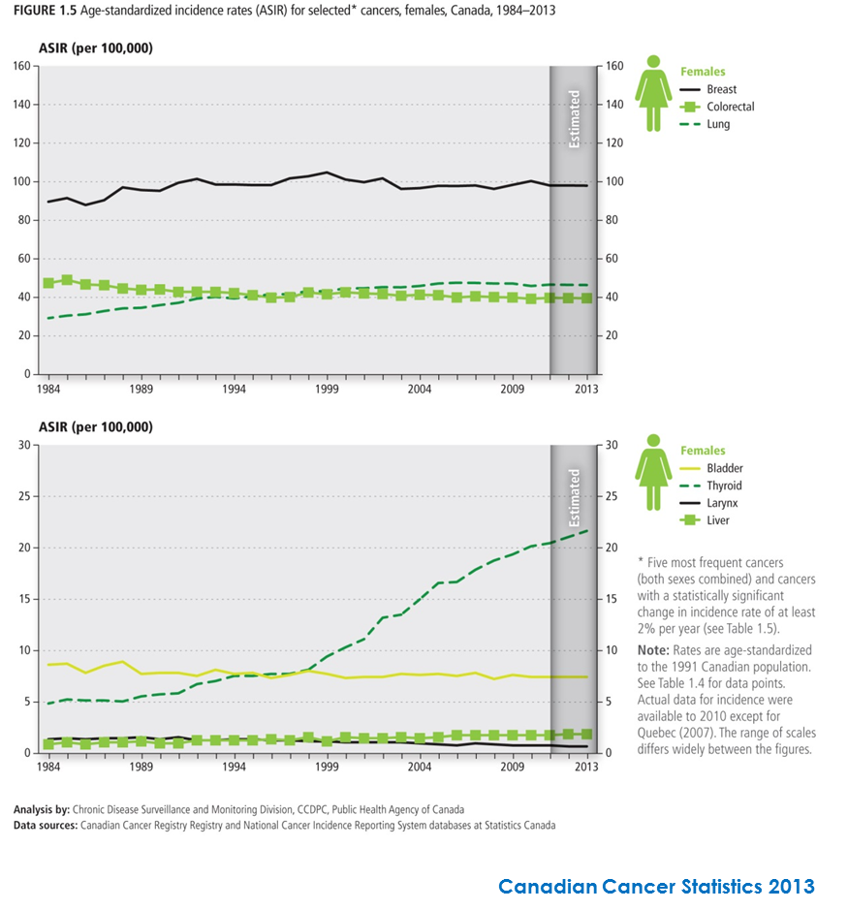
Canadian Cancer Society 2013 Statistics
Cancer INCIDENCE - Females

Slide 16
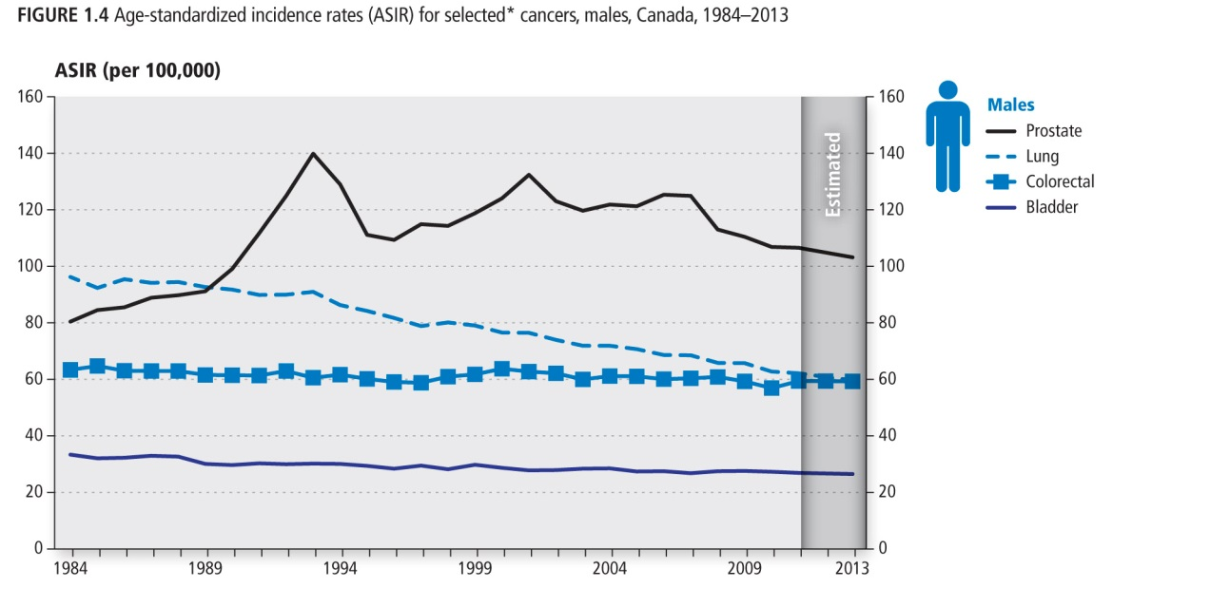
Canadian Cancer Society 2013 Statistics
Cancer INCIDENCE - Males

Slide 17
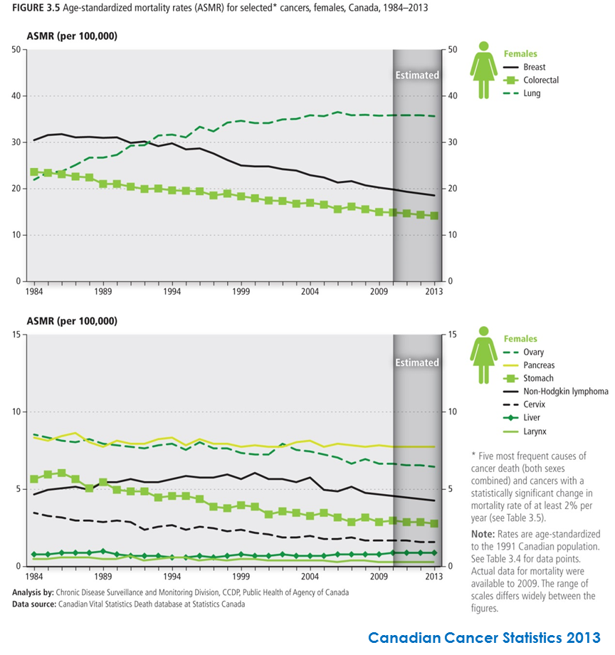
Canadian Cancer Society 2013 Statistics
Cancer MORTALITY - Females

Slide 18
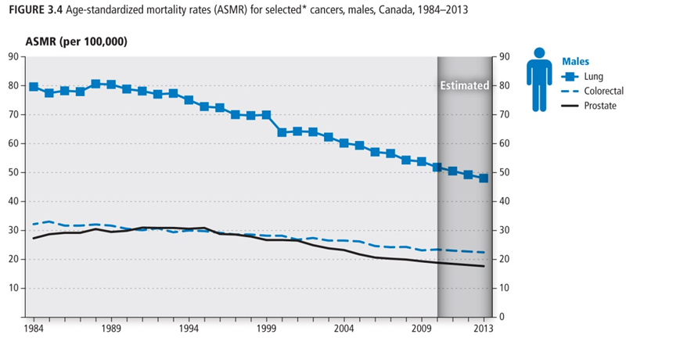
Canadian Cancer Society 2013 Statistics
Cancer MORTALITY - Males

Slide 19
Epidemiology of cancer
The incidence of cancer, adjusted for aging, has been rising slightly in the past decade for both men and women
While mortality has been going down for most of the common cancers, an important exception is lung cancer in women, due almost exclusively to smoking
These next two slides break up the incidence and mortality by age and population growth, showing that aging is responsible for a large part of increasing incidence and mortality

Slide 20
Factors accounting for increased cancer incidence

Slide 21
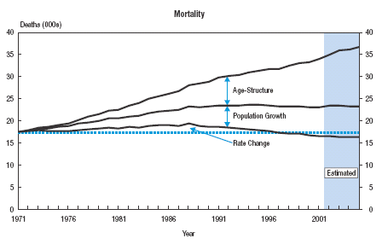
Factors accounting for increased cancer mortality

Slide 22
Oncology Quiz
Q1. What are the most common incident cancers in Canadian women?
  Breast, lung, colorectal
  Breast, colorectal, lung
  Breast, lymphoma, colorectal
  Lymphoma, breast, colorectal

Slide 23
Oncology Quiz
Q1. What are the most common incident cancers in Canadian women?
  Breast, lung, colorectal
  Breast, colorectal, lung
  Breast, lymphoma, colorectal
  Lymphoma, breast, colorectal

Slide 24
Oncology Quiz
Q2. What are the most common incident cancers in Canadian men?
  Prostate, lung, colorectal
  Lung, prostate, colorectal
  Prostate, colorectal, lung
  Prostate, colorectal, bladder

Slide 25
Oncology Quiz
Q2. What are the most common incident cancers in Canadian men?
  Prostate, lung, colorectal
  Lung, prostate, colorectal
  Prostate, colorectal, lung
  Prostate, colorectal, bladder

Slide 26
Oncology Quiz
Q3. What are the most common causes of cancer death in Canadian women?
  Breast, lung, colorectal
  Lung, breast, colorectal
  Breast, lymphoma, colorectal
  Lymphoma, breast, colorectal

Slide 27
Oncology Quiz
Q3. What are the most common causes of cancer death in Canadian women?
  Breast, lung, colorectal
  Lung, breast, colorectal
  Breast, lymphoma, colorectal
  Lymphoma, breast, colorectal

Slide 28
Oncology Quiz
Q4. What are the most common causes of cancer death in Canadian men?
  Prostate, lung, colorectal
  Lung, prostate, colorectal
  Lung, colorectal, prostate
  Lung, colorectal, bladder

Slide 29
Oncology Quiz
Q4. What are the most common causes of cancer death in Canadian men?
  Prostate, lung, colorectal
  Lung, prostate, colorectal
  Lung, colorectal, prostate
  Lung, colorectal, bladder

Slide 30
Outline
What is geriatric oncology?
Burden of cancer in older adults
What’s so special about growing old?

Slide 31
What is old?
65
Courtesy of Dr. A. Hurria, City of Hope
Notes:
31

Slide 32
What is old?
65
65
As in many other fields, it is important to recognize that we don’t suddenly ‘age’ as we turn 65. Aging is a gradual process that affects us all but becomes more clinically noticeable once we reach 70 or 75.
Courtesy of Dr. A. Hurria, City of Hope
Notes:
32

Slide 33
What’s so special about growing old?
Decreasing life expectancy
Altered pharmacokinetics/dynamics as well as homeostenosis
Increasing comorbidity (competing causes of mortality)
Increasing cognitive and functional impairment
Increasing frailty
Limited oncology evidence base

Slide 34
What’s so special about growing old?
All six of these factors make it challenging to manage older adults with cancer because they make the risk:benefit ratio of treatment less clear as we age

Slide 35
Projected life expectancy (years)
Age now Life Expectancy Age of Death
65 17.7 82.7
70 14.3 84.3
75 11.2 86.2
80 8.5 88.5
85 6.3 91.3
90 4.5 94.5
95 3.3 98.3
100 2.5 102.5
National Vital Statistics Report

Slide 36
Altered physiology/organ reserve
Aging affects virtually all organs and tissues and leads to reduced reserves
Key organ systems impacting cancer treatment:
  Reduced bone marrow function
  Reduced wound healing
  Reduced renal function
  Reduced hepatic oxidation
  Reduced mucosal integrity and reparative ability

Slide 37
Comorbidity
Definition:
Concurrent, independent health condition which may be a predictor of survival and resource requirements
Key questions:
Is the patient going to die from cancer or another medical problem?
Will another medical problem limit the ability to tolerate treatment?

Slide 38
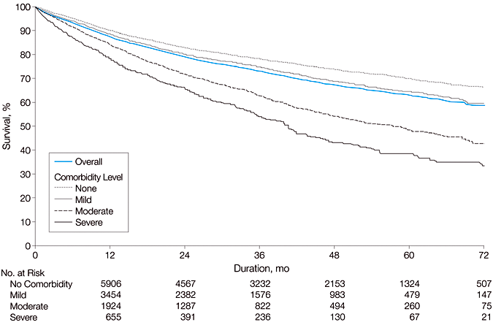
Relationship Between Severity of Comorbidity and Overall Survival
Piccirillo JAMA 2004; 291:2441
Copyright restrictions may apply.

Slide 39
Age, comorbidity & life expectancy
Synergistic interaction between age & comorbidity (as measured by the ICED index in one study, higher = more comorbidity):
Age ICED 0 ICED 1 ICED 2 ICED 3
65 12.5 y 10.7 y 7.1 y 2.3 y
70 9.8 y 8.3 y 5.4 y 1.6 y
75 7.5 y 6.3 y 3.9 y 1.1 y
Albertsen JAMA 1995; 274:626

Slide 40
Limited oncology evidence base
Poor recruitment of older adults into clinical trials
Limited # of older adults even in many large trials to facilitate subgroup analyses
Highly selected older adults in clinical trials (limited comorbidity, not disabled/frail, cognitively intact), which makes extrapolating results to the real world difficult

Slide 41
Outline
What is geriatric oncology?
Burden of cancer in older adults
What’s so special about growing old?
Age and treatment toxicity

Slide 42
Q5. Which of the following age-related changes may affect the ability of patients to tolerate cancer treatment?
Reduced muscle mass
Decreased renal function
Decreased hepatic function
Reduced bone marrow reserve
Reduced GI tract mucosal integrity
All of the above

Slide 43
Age & Treatment toxicity
Given myriad alterations with aging in physiologic reserve at cellular and organ/tissue levels, increasing data show that older adults generally experience greater toxicities from cancer treatment
However, not all treatment modalities are equally affected, and it’s not just about age

Slide 44
Age & Treatment toxicity
SURGERY – increased short-term mortality and complications from major surgeries, particularly complex surgical procedures with volume-outcome relationships (e.g. oesophagectomy)
Increased risks with age are generally small relative to risks from comorbidity
However, sometimes these risks are great enough that other treatment options should be considered

Slide 45
Age & Treatment toxicity
RADIATION – generally well-tolerated despite increased age
Slightly increased risks of GI toxicity with radiation (diarrhoea, bleeding)
Some increased risk of cognitive impairment with whole brain RT, but data are limited

Slide 46
Age & Treatment toxicity
CHEMOTHERAPY – most data are related to chemotherapy, particularly for the most common solid tumours and lymphoma
Greater risk of haematologic toxicity, including febrile neutropenia and sepsis
Somewhat increased risk of GI toxicity (mucositis, diarrhoea)
Most other organ system toxicities are only slightly affected or unaffected by age (but recall that many comorbidities are increasingly common with older age)

Slide 47
Q5. Which of the following age-related changes may affect the ability of patients to tolerate cancer treatment?
Reduced muscle mass
Decreased renal function
Decreased hepatic function
Reduced bone marrow reserve
Reduced GI tract mucosal integrity
All of the above

Slide 48
Q5. Which of the following age-related changes may affect the ability of patients to tolerate cancer treatment?
Reduced muscle mass
Decreased renal function
Decreased hepatic function
Reduced bone marrow reserve
Reduced GI tract mucosal integrity
All of the above

Slide 49
Outline
What is geriatric oncology?
Burden of cancer in older adults
What’s so special about growing old?
Age and treatment toxicity
Value of comprehensive geriatric assessment

Slide 50
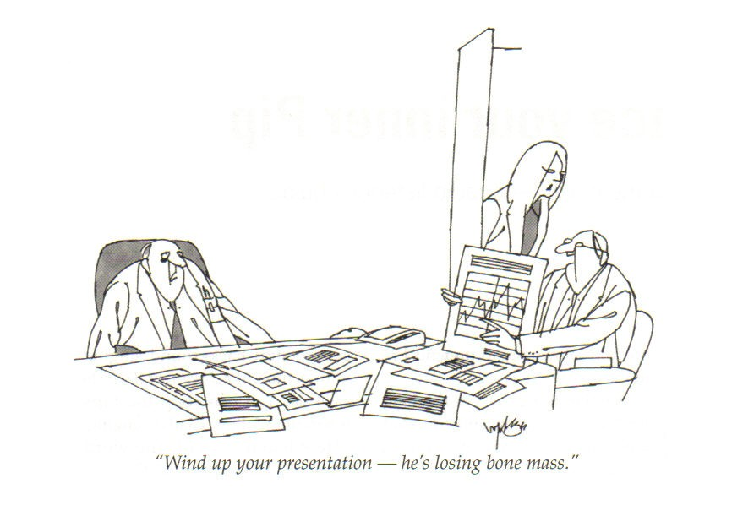

Slide 51
Comprehensive geriatric assessment
“A multidisciplinary diagnostic process intended to determine a frail elderly person’s medical, psychosocial, and functional capabilities and limitations in order to develop an overall plan for treatment and long-term follow-up”
Rubenstein, 1982

Slide 52
Comprehensive geriatric assessment
Key components of CGA:
  Physical Health
    Comorbidity
    Polypharmacy
    Nutritional status
  Functional status
  Psychological function
    Cognition
    Mood
  Socioenvironmental factors

Slide 53
Value of CGA in oncology
Systematic assessment of older adults with cancer can help:
Improve prognostication (better predict remaining life expectancy and competing risks of mortality from non-cancer causes)
Identify conditions that were not known to the oncology team and may influence cancer management
Optimize patients to reduce treatment toxicity

Slide 54
Outline
What is geriatric oncology?
Burden of cancer in older adults
What’s so special about growing old?
Age & treatment toxicity
Value of CGA
Summary

Slide 55
Summary
Cancer disproportionately affects older adults in terms of incidence, morbidity, and mortality
Older patients with cancer have more comorbidity, disability, polypharmacy, and altered physiology that impact all aspects of oncology
Evidence base to treat older adults with cancer limited in several ways

Slide 56
Summary
Risks of cancer treatment due to age are less important than comorbidity in surgery, not particularly important with radiotherapy, but increase risk of several chemotherapy-related toxicities, particularly haematologic complications and GI toxicities
CGA can help oncologists to better characterize and optimize older adults considering cancer treatment

Slide 57


Slide 58
Suggested Reading
Pallis, A. G., et al. (2010). "EORTC elderly task force position paper: approach to the older cancer patient." European Journal of Cancer 46(9): 1502-1513.
Sawhney, R., et al. (2005). "Physiologic aspects of aging: impact on cancer management and decision making, part I." Cancer Journal 11(6): 449-460.
Sehl, M., et al. (2005). "Physiologic aspects of aging: impact on cancer management and decision making, part II." Cancer Journal 11(6): 461-473.
Naeim, A., et al. (2014). "Supportive care considerations for older adults with cancer." Journal of Clinical Oncology 32(24): 2627-2634.

